Slide 1
Experimental Design For Engineers
ISYE435-535

Slide 2
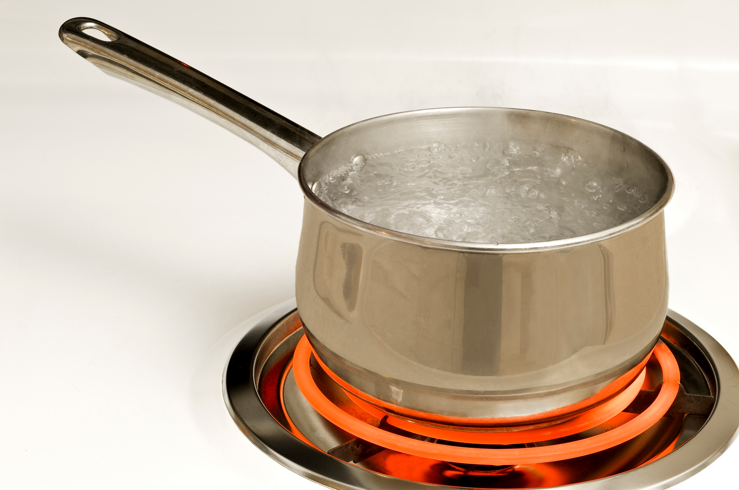
Factors for Boiling Water
Boiling water:
Factors: pan type, burner size, cover
Response: time to boil water
Can you think of other
factors?

Slide 3
What is Response Surface Analysis?
Definition
It is a combination of Regression plus Design of Experiments in order to “Optimize” a real System.

Slide 4
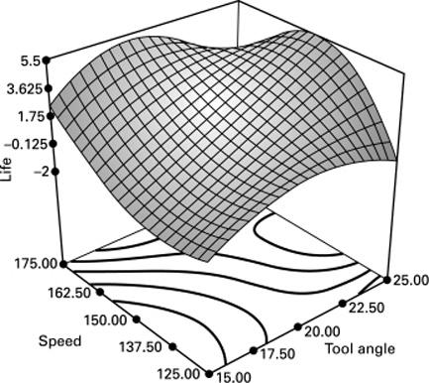
RSM – Regression
We are going to fit a model similar to this:

Slide 5
RSM – Optimization
Look for the setting (x₁,x₂) that produces the best value for y.
Setting of Tool angle (x₁) and Speed (x₂) that produces the best life (y).

Slide 6
RSM – Design of Experiments
It has to do with how to collect data at a minimum cost to produce the necessary amount of information that allows us to fit a surface to optimize our system.

Slide 7
Introduction to DOE
An experiment is a test or a series of tests
Experiments are used widely in the engineering world
Process characterization & optimization
Evaluation of material properties
Product design & development
Component & system tolerance determination
“All experiments are designed experiments, some are poorly designed, some are well-designed”

Slide 8
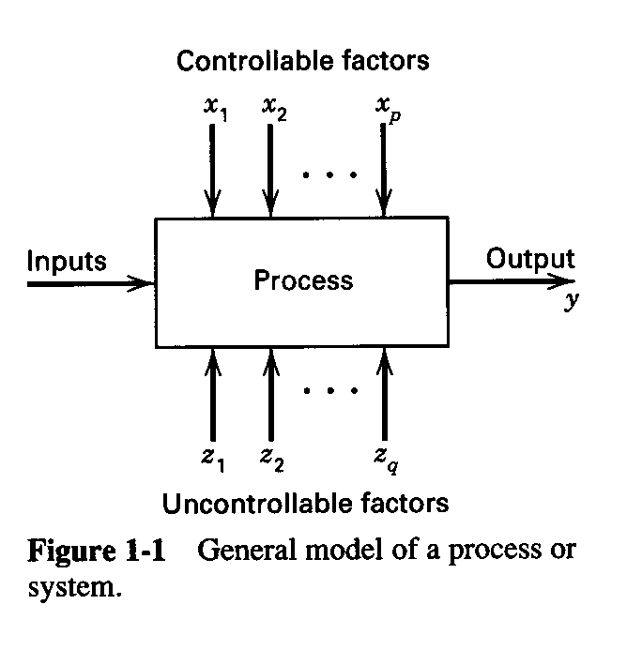
Engineering Experiments
Reduce time to design/develop new products & processes
Improve performance of existing processes
Improve reliability and performance of products
Achieve product & process robustness
Evaluation of materials, design alternatives, setting component & system tolerances, etc.

Slide 9
Four Eras in the History of DOE
The agricultural origins, 1918 – 1940s
R. A. Fisher & his co-workers
Profound impact on agricultural science
Factorial designs, ANOVA
The first industrial era, 1951 – late 1970s
Box & Wilson, response surfaces
Applications in the chemical & process industries
The second industrial era, late 1970s – 1990
Quality improvement initiatives in many companies
Taguchi and robust parameter design, process robustness
The modern era, beginning circa 1990

Slide 10
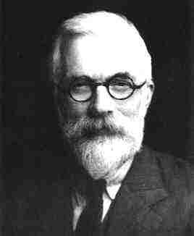
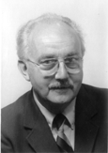
R. A. Fisher (1890 – 1962)
George E. P. Box

Slide 11
The Basic Principles of DOE
Randomization
Running the trials in an experiment in random order
Notion of balancing out effects of “extraneous” variables
Replication
Sample size (improving precision of effect estimation, estimation of error or background noise)
Replication versus repeat measurements?
Blocking
Dealing with nuisance factors

Slide 12
Strategy of Experimentation
“Best-guess” experiments
Used a lot
More successful than you might suspect, but there are disadvantages…
One-factor-at-a-time (OFAT) experiments
Sometimes associated with the “scientific” or “engineering” method
Devastated by interaction, also very inefficient
Statistically designed experiments
Based on Fisher’s factorial concept

Slide 13
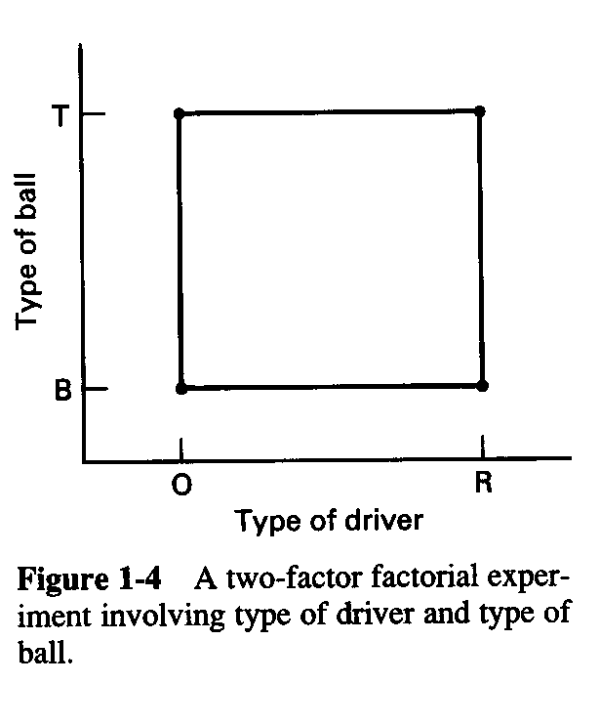
Factorial Designs
In a factorial experiment, all possible combinations of factor levels are tested
The golf experiment:
Type of driver (Oversized or Regular)
Type of ball (Balata or Three-piece)
Walking vs. riding
Type of beverage (Water or Beer)
Time of round
Weather
Type of golf spike
Etc, etc, etc…

Slide 14
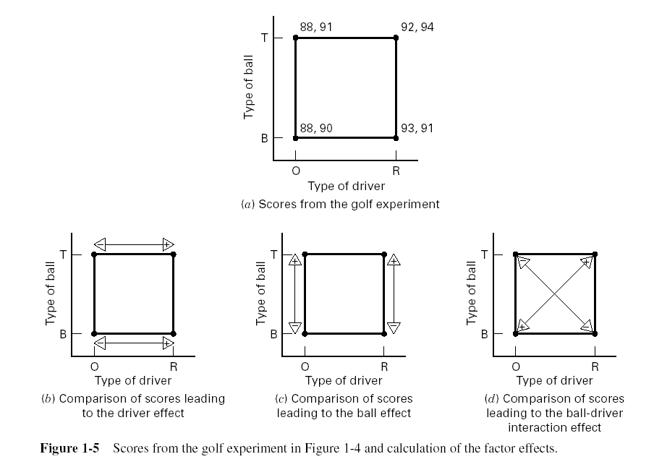
Factorial Design

Slide 15
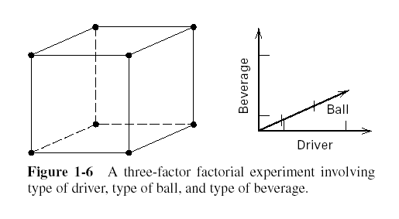
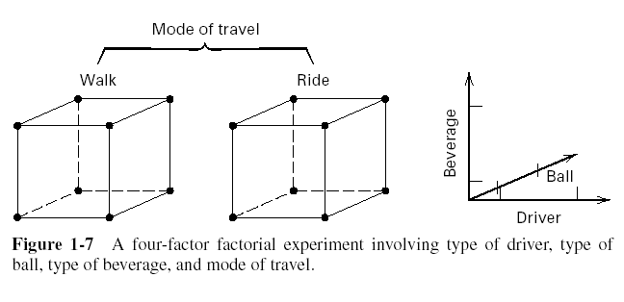
Factorial Designs with Several Factors

Slide 16
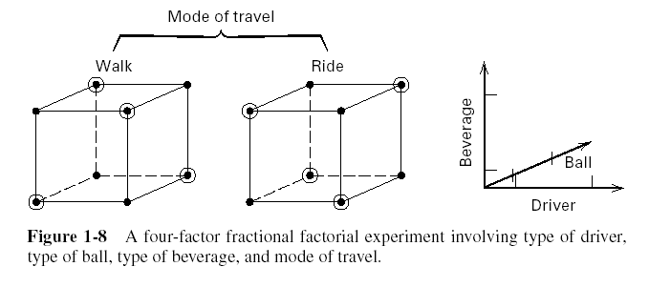
Factorial Designs with Several Factors A Fractional Factorial

Slide 17
Planning, Conducting & Analyzing an Experiment
Recognition of & statement of problem
Choice of factors, levels, and ranges
Selection of the response variable(s)
Choice of design
Conducting the experiment
Statistical analysis
Drawing conclusions, recommendations

Slide 18
Planning, Conducting & Analyzing an Experiment
Get statistical thinking involved early
Your non-statistical knowledge is crucial to success
Pre-experimental planning (steps 1-3) vital
Think and experiment (use the KISS principle)

Slide 19
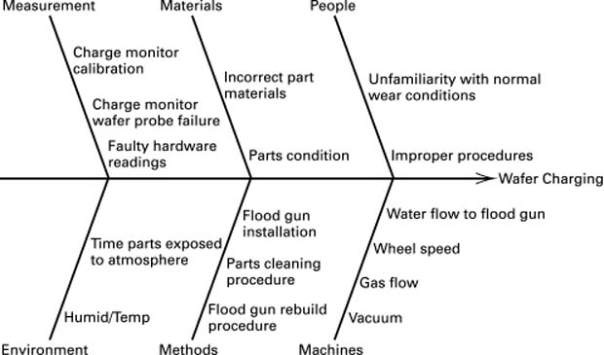
Planning, Conducting & Analyzing an Experiment
Cause-effect diagram

Slide 20
Think of Factors
Microwave popcorns:
Factors:
Response: taste
Photography:
Factors:
Response: quality of slides

Slide 21
Propose your own examples
Give two examples:

Slide 22
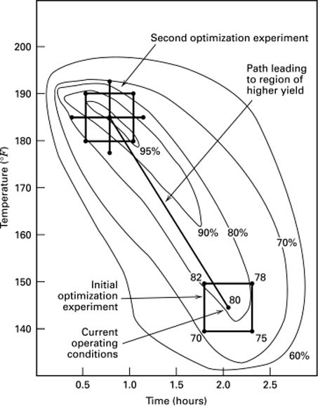
DOE/RSM – Optimization
Screening
Improvement
Optimization

